Slide 1

Prediction of Women safety using twitter data
18CSP83
Review 2
Date : 15/04/23
Team No : SC58
1CR19CS105 NIDHI GURUNATH NAIK
1CR19CS109 Nikita sinha
1CR19CS110 NIKKY NIKITA
Under the guidance of:
Mrs Poonam V.Tijare
Assistant Professor
Department of Computer Science & Engineering
Notes:
1

Slide 2
Abstract
2
A lot of Women have been experiencing a lot of trolling and harassment in public places in various cities starting from stalking to passing offensive comments. Our project basically focuses on the role of social media in promoting the safety of women in Indian cities with special reference to the role of social media websites and applications including Twitter platform Facebook .Analysis of Women Safety in Indian Cities Using Twitter data is to analyze women safety using social networking messages and by applying machine learning algorithms on it ,also focuses on how a sense of responsibility on part of Indian society can be developed on the common Indian people so that we should focus on the safety of women surrounding them.

Slide 3
Progress & Status
3
We imported the datasets.
We installed the packages.
We used nltk to remove special symbols and stop words.
Data cleaning is done.
Data preprocessing done.
Code execution
Outcome prediction
Graphical representation completed.

Slide 4
Outline
4
Introduction
Problem Statement
Relevance of the Problem
Project Schedule Phase II
Objectives
Proposed System
Proposed System
Architecture
Design
Implementation
Conclusion
References

Slide 5
Introduction
5
Twitter in this modern era has emerged as an ultimate microblogging social network consisting over hundred million users and generate over five hundred million messages known as ‘Tweets’ every day.
On the twitter, users will share their opinions and perspective in the tweets section. This tweet can only contain 140 characters, thus making the users to compact their messages with the help of abbreviations, slang, shot forms, emoticons, etc. In addition to this, many people express their opinions by using polysemy and sarcasm also. Hence twitter language can be termed as the unstructured. From the tweet, the sentiment behind the message is extracted.

Slide 6
Problem Statement
6
Analysis of women safety on twitter data using machine learning algorithm.

Slide 7
Relevance of the Problem
7
By using twitter, we can overcome all the obesity, complexity, information, harassments all the uncertainties and we can reach the person using sentiment analysis. On twitter, every user will share opinions and perspectives regarding their emotions using slangs, paragraphs, short forms and abbreviations.

Slide 8
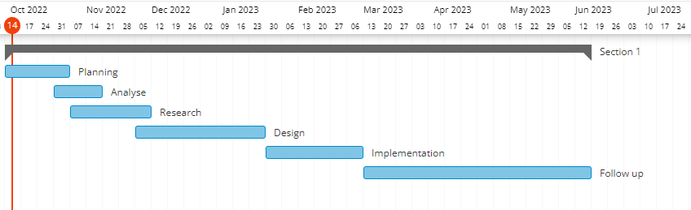
Project Schedule
8
Gantt Chart

Slide 9
Objectives
9
This project is to analyse women safety using social networking messages and by applying machine learning algorithms on it. Now-a-days almost all peoples are using social networking sites to express their feelings and if any women feel unsafe in any area, then she will express negative words in her post/tweets/messages and by analysing those messages we can detect which area is more unsafe for women’s.

Slide 10
Architecture of Proposed System
10

Slide 11
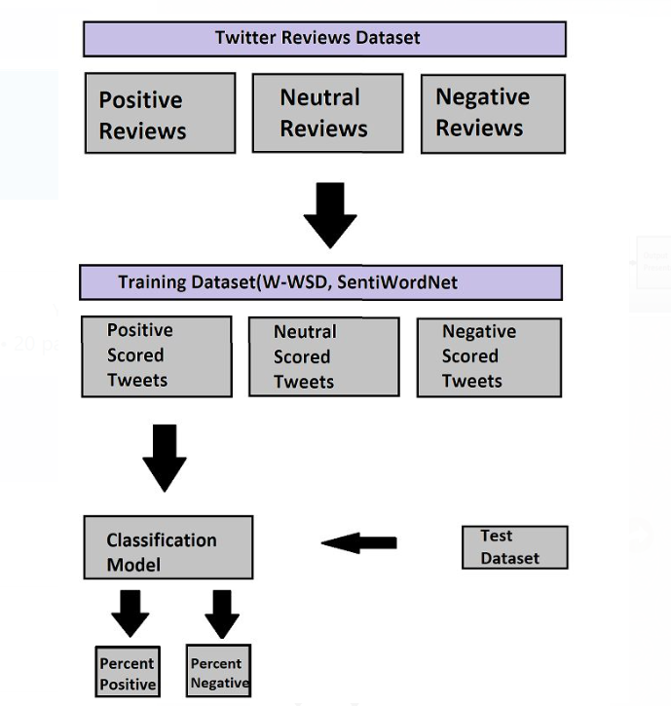
Architecture
11

Slide 12
Design
12

Slide 13
Design
13
Pre processing
DATASET
Feature
Extraction
Classifier
Output

Slide 14
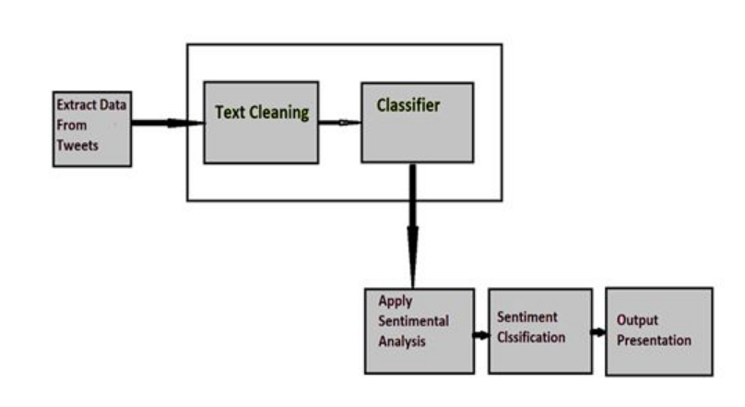
Sample ML Design
14

Slide 15
Development tools
Hardware
Software
Testing tools

Slide 16
Software requirement
• Python idle 3.7 version (or)
• Anaconda 3.7 (or)
• Google Collaboratory
Hardware requirement
• Operating system :windows
• Processor : minimum intel i3
• Ram : minimum 4gb
• Hard disk : minimum 250gb

Slide 17
Implementation
Algorithm
Flowchart
Explanation

Slide 18
Algorithm /Flowchart
Information extraction
Text cleaning
Sentimental analysis
Sentiment classification
Output presentation

Slide 19
Explanation
INFORMATION EXTRACTION: This aides in separating the tweet message from the interpersonal organization stage and this messages additionally additional information like tweets likes, abhorrence’s and remarks.
2) TEXT CLEANING: Post the information extraction the data must be passed to the classifier. The classifier Clean tweets by eliminating the stop words, non-text-based substance and commotion like monotonous letters.
3) SENTIMENT ANALYSIS: Once the classifier cleans the dataset, the information is prepared for the nostalgic investigation measure. AI approaches includes in Training the dataset and afterward testing that prepared dataset. Prepared and tried information are helpful for the classifier to play out the calculation.

Slide 20
Continue…
4) SENTIMENT CLASSIFICATION: In this progression, Every single sentence of the tweet will be analyzed and assessment will be framed appropriately, for subjectivity. Emotional articulation sentences are held are characterized into acceptable, terrible or like, abhorrence or positive and negative. For target articulation sentences are dismissed.
5) OUTPUT PRESENTATION: Once the calculation is finished, the yield of the investigation can be envisioned by making various sorts of charts.

Slide 21
Demo
21

Slide 22
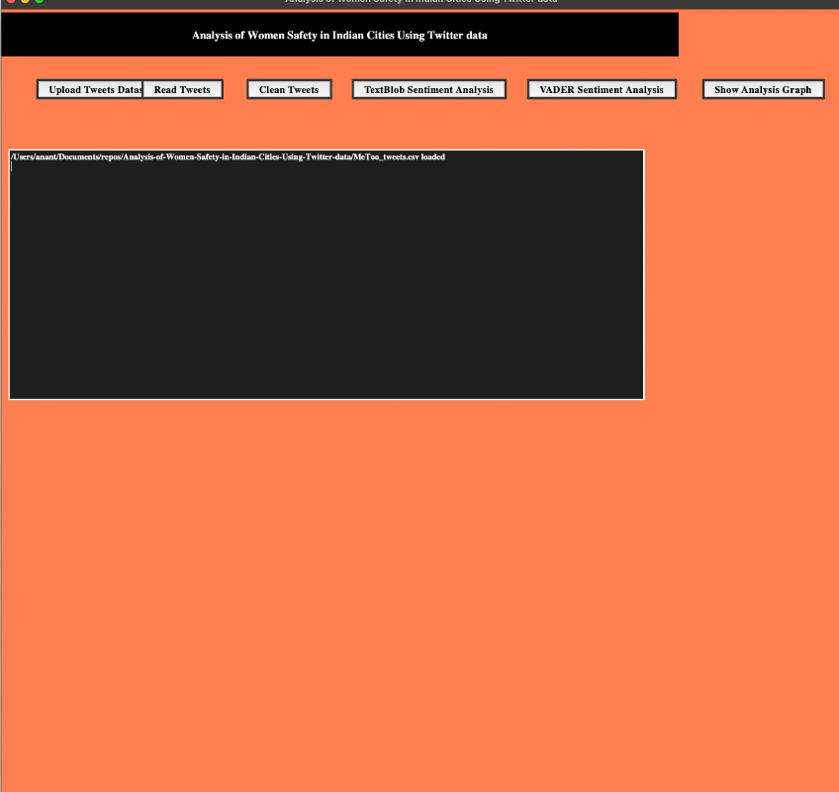
First page

Slide 23
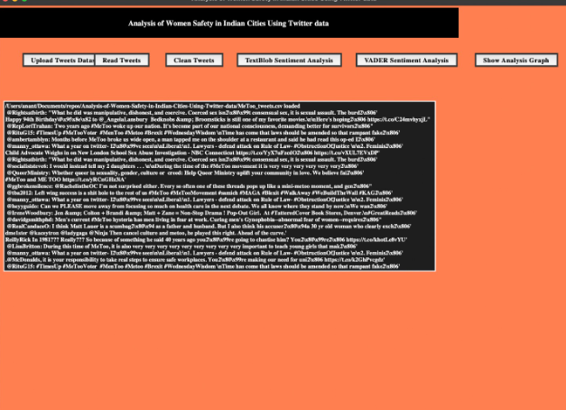
Before text cleaning

Slide 24
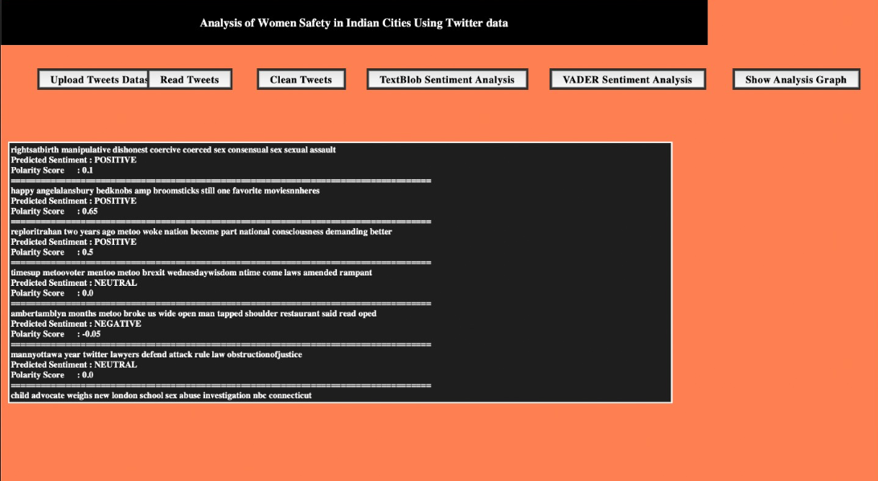
Predicting sentiment using Textblob

Slide 25
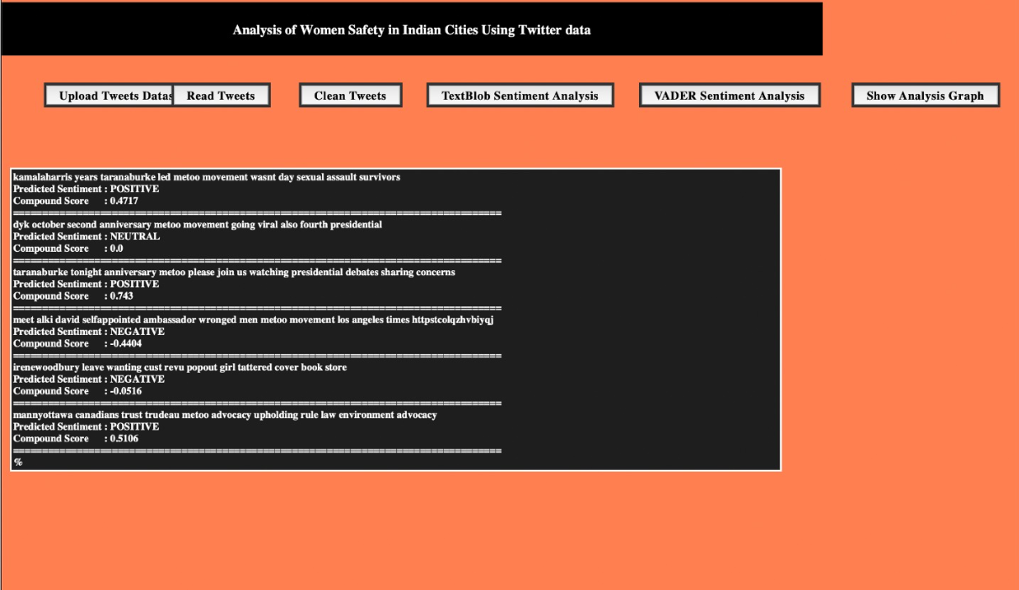
Vader sentiment analysis

Slide 26
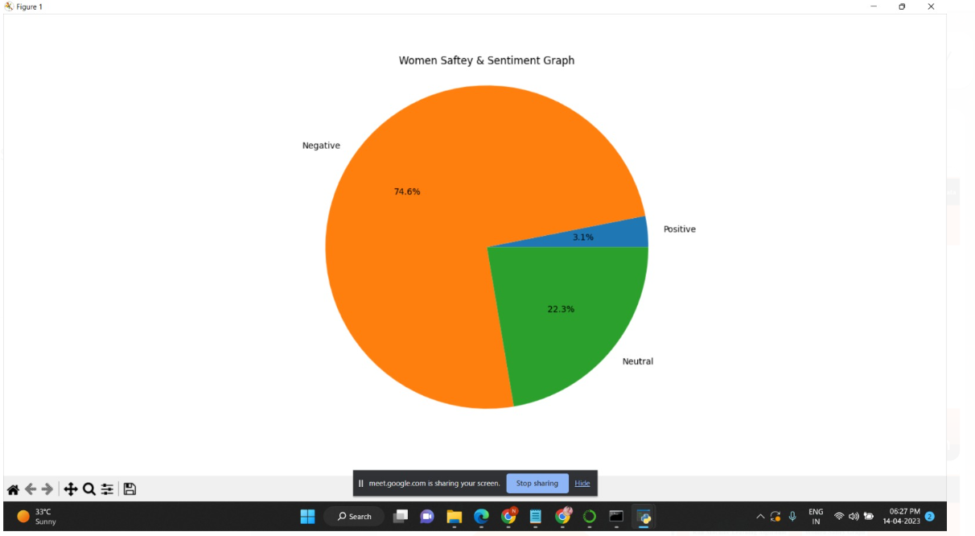
Graph depicting polarity

Slide 27
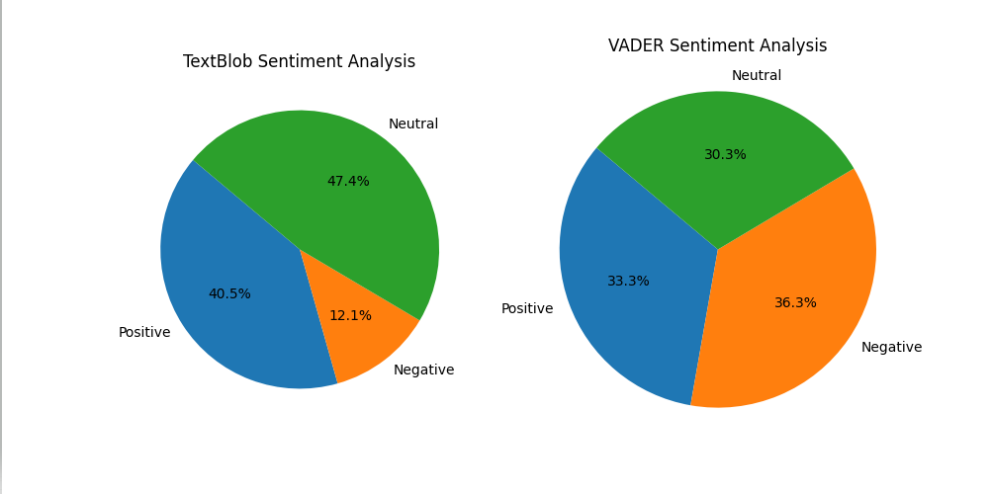
Comparison

Slide 28
Conclusion
AI calculation has been examined all through the venture. For the twitter information that incorporates a huge number of tweet and messages each day, AI calculation assists with getting sorted out and perform investigation. SPC calculation, direct mathematical are a portion of the calculations which are powerful in dissecting the huge information that give arrangement and convert into significant datasets. Subsequently we can perform AI calculations to accomplish nostalgic examination and carry more security to women by spreading the mindfulness.

Slide 29
References
[1] Deepak Kumar1, Shivani Aggarwal2 "Analysis of Women Safety in Indian Cities Using Machine Learning on Tweets", (IEEE), 2019.
[2] Teja KR, Kumar KA, Praveen GS, Harini DN. Analysis of Crimes Against Women in India Using Machine Learning Techniques. In Communication Software and Networks 2021 (pp. 499-510). Springer, Singapore.
[3] Vikram Chandra1, Rampur Srinath2 "Analysis of Women Safety using Machine Learning on Tweets", (IRJET) 2020.
[4] P. Anbumani and R. Dhanapal, "Review on Privacy Preservation Methods in Data Mining Based on Fuzzy Based Techniques," 2020 2nd International Conference on Advances in Computing, Communication Control and Networking (ICACCCN).

Slide 30
THANK YOU
30

